Slide 1
Jenkins
Software Engineering Practice Lab

Slide 2
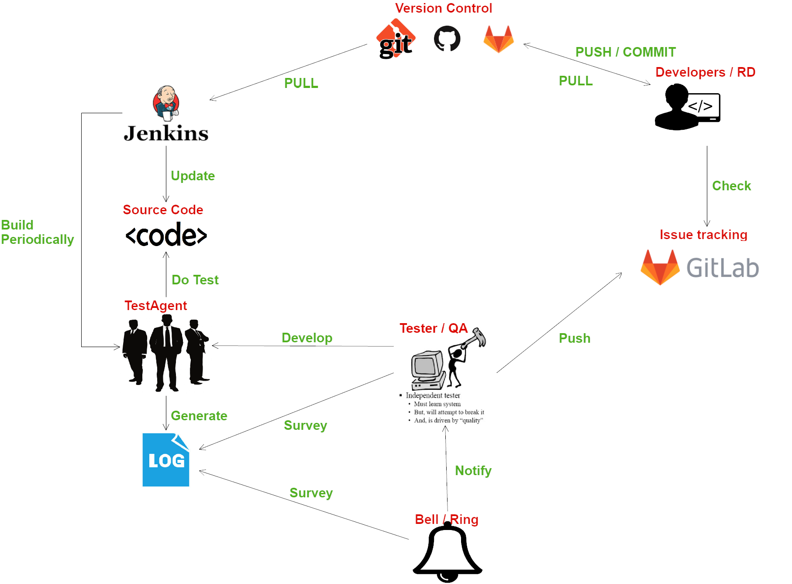

Slide 3
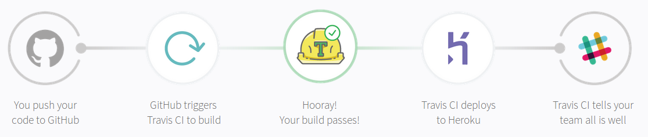
Continuous Integration & Continuous Delivery
Building, Testing, Deploying The goal of CI/CD is to build healthier software by developing and testing in smaller increments (code changes) frequently ...
https://travis-ci.org/
https://docs.travis-ci.com/user/for-beginners/

Slide 4
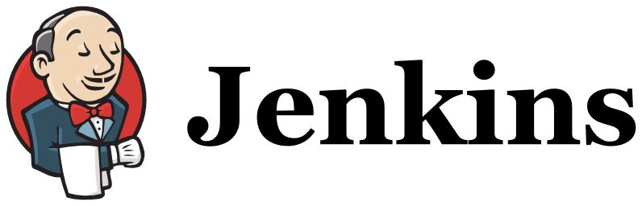
About Jenkins
A self-contained, open source automation server which can be used to automate all sorts of task related to building, testing and delivering or deploying software.
Can be installed through native system packages, docker, or standalone Java Executable.
Provides over 1600 plugins to support automating virtually anything, make humans can actually spend their time doing things machines cannot.
https://jenkins.io/doc/
https://github.com/jenkinsci/jenkins

Slide 5
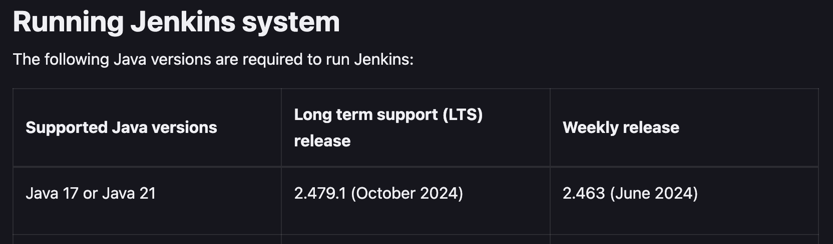
Installing JDK / JRE 17(if you haven’t)
Install Java Development Kit / Java Runtime Environment 17 https://www.oracle.com/java/technologies/javase/jdk17-0-13-later-archive-downloads.html

Slide 6
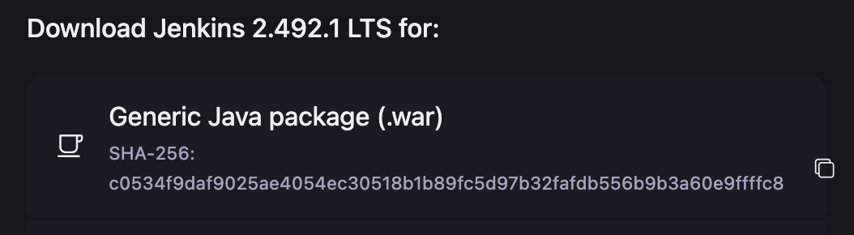
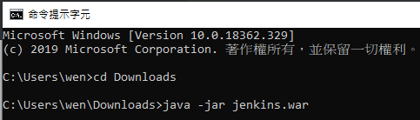
Download and launch Jenkins master server
Go to jenkins.io/download
Download Generic Java Package (.war)
3. Launch Jenkins.war via terminal/cmd, allow firewall if needed.
$ java -jar jenkins.war

Slide 7
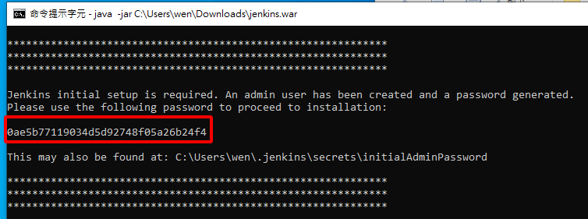
Get first-time password of Jenkins
First time password will appear on the terminal. Copy it for pasting later. Maybe you need to scroll up and down to find where it is. If you cant see it, follow the instruction of Jenkins webpage later to find the password.

Slide 8

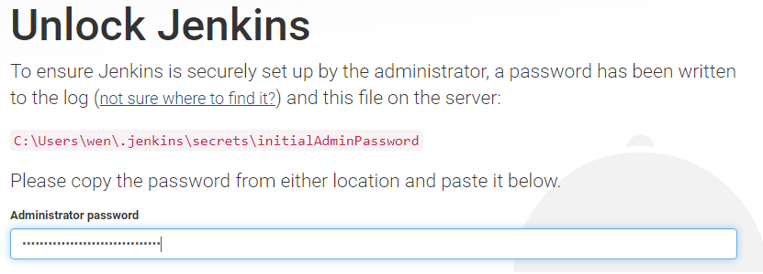

Setup Jenkins (1)
# Jenkins will display in the language which you set as preferred # in your browser.
1. Launch your browser and go to localhost:8080
2. Provide the password and click continue on the webpage.

Slide 9
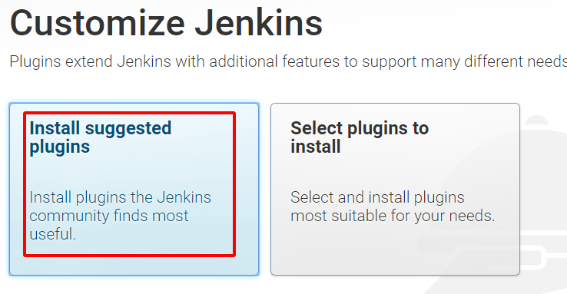
Setup Jenkins (2)
3. Install suggested plugins. Although we may not use many of its features in this lab, you can try them to make CI/CD more effective. For example, pipeline is useful to automate different test processes/suites of a software.
https://jenkins.io/doc/book/pipeline/

Slide 10
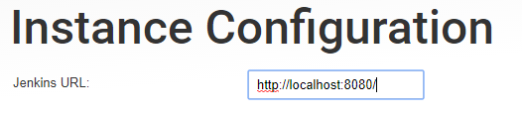
Setup Jenkins (3)
4. Create first user. Provide your information to login Jenkins later. If you want to be notified by emails of Jenkins test results, make sure correct address is provided. Save and continue.
5. Set Jenkins URL Keep default if you do not need to connect Jenkins from another device. Save and Finish. Start using Jenkins.
# You will need to launch Jenkins from cmd/terminal if you shut the PC down or # accidentally turn it off. Task scheduler or crond may help you to turn Jenkins on # automatically.

Slide 11
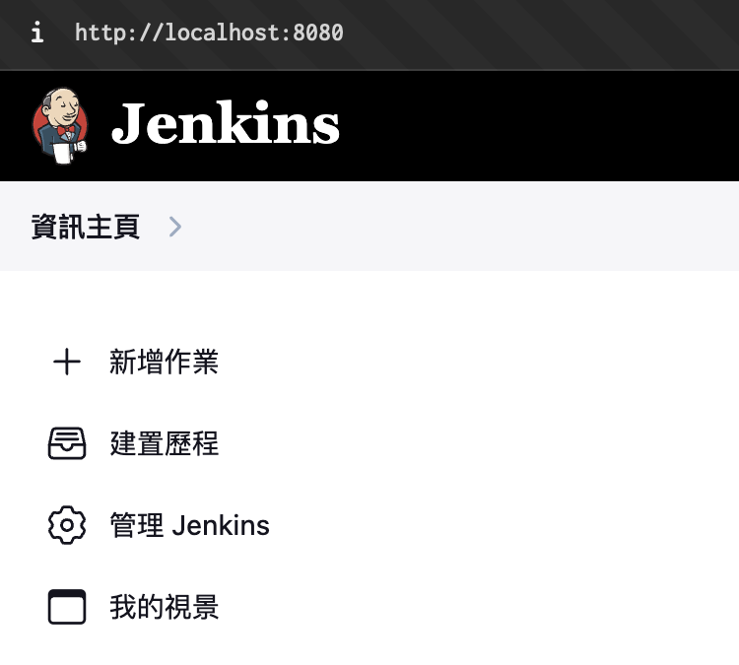
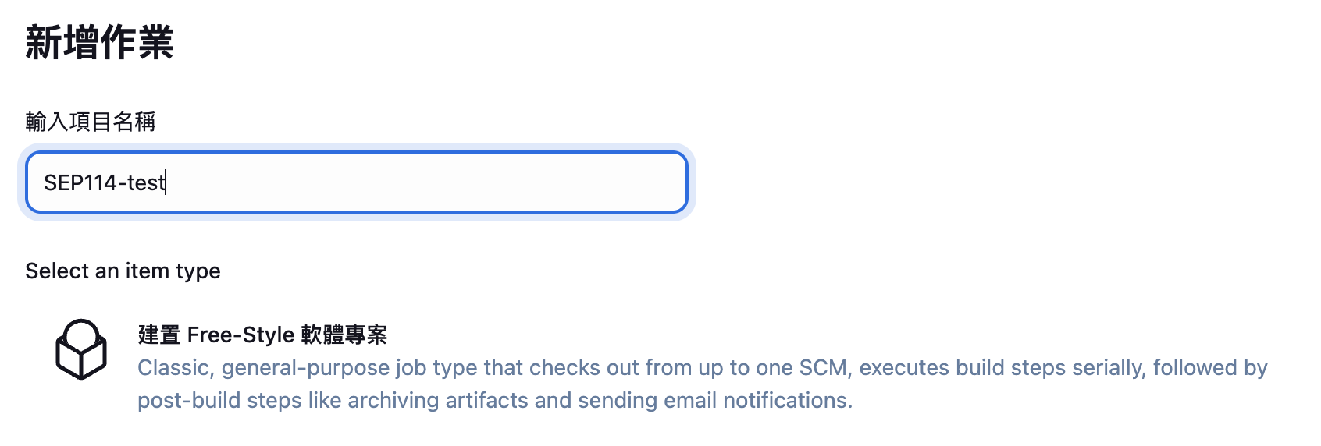
Add a new Job
As our first Jenkins job, click New Item, enter a name and choose Freestyle project. then OK.

Slide 12
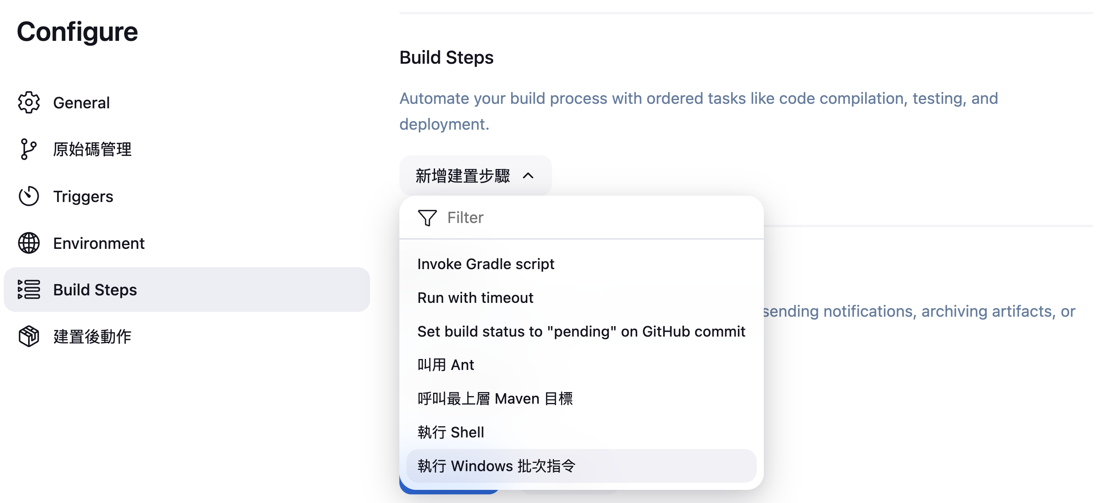
Add a new Job
Click Build tab on the top of the page, and add Execute Windows batch command step to this build job.

Slide 13
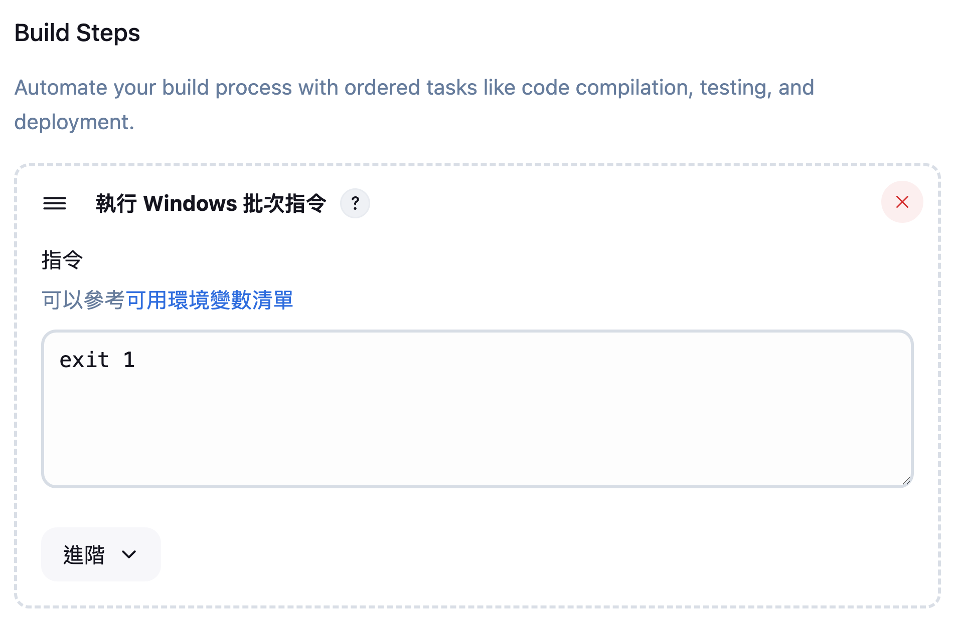
Add a new Job
Enter exit 1, and Save to simulate a failed build.

Slide 14
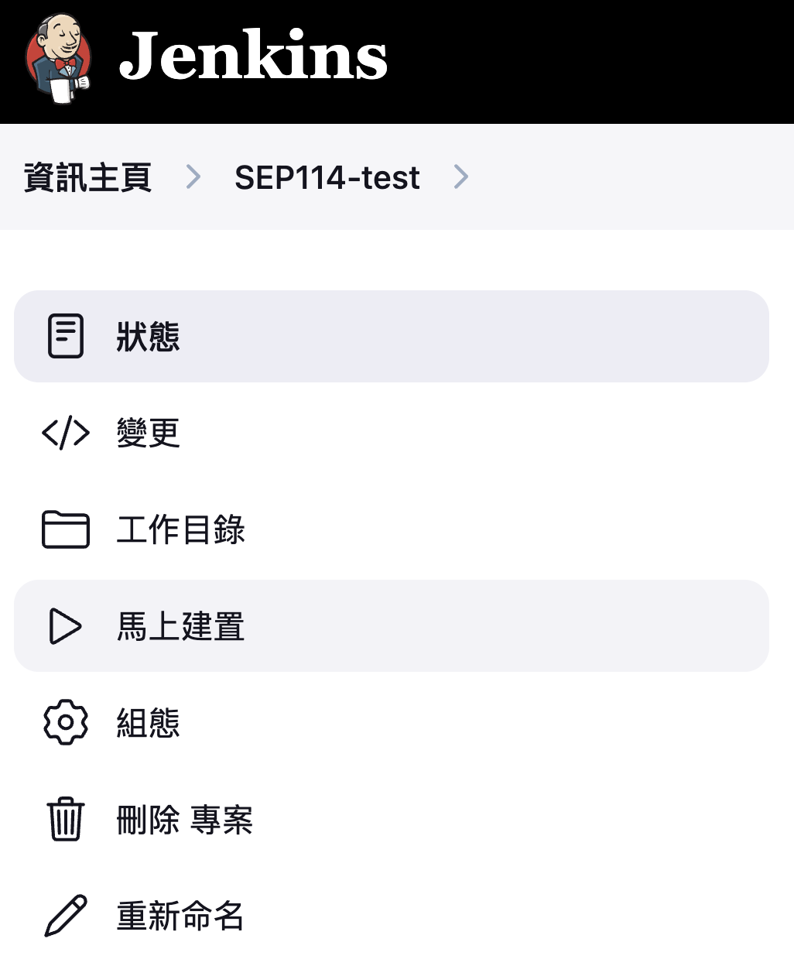
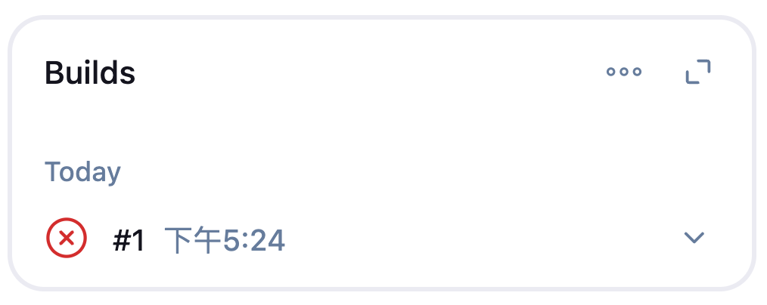
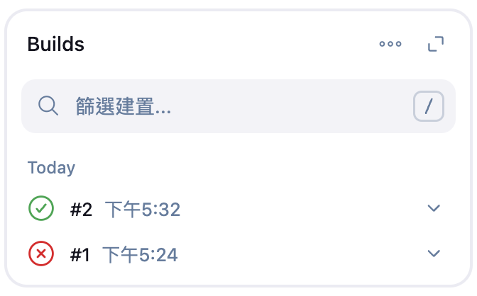
Add a new Job
Click Build Now to see it fails successfully.
Click Configure and modify exit 1 to exit 0.
2
1
3
4
# Return value matters!

Slide 15
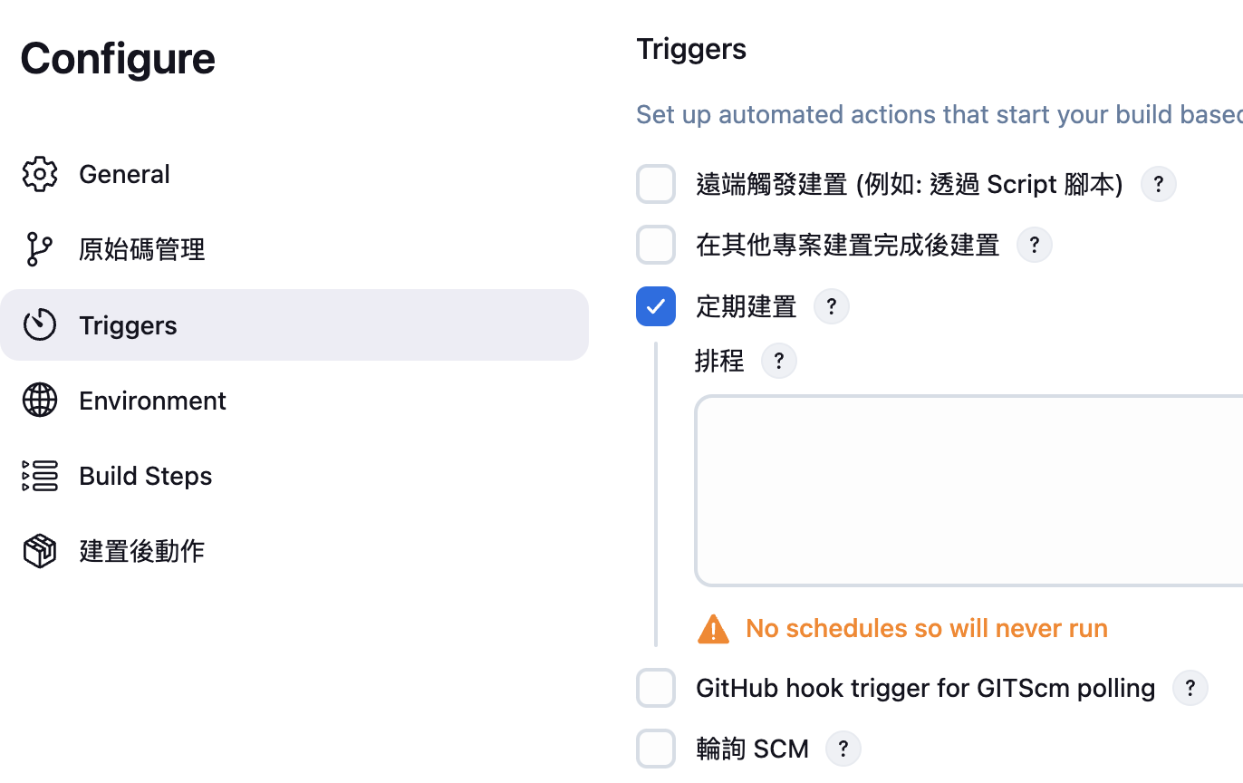
Build periodically
Build can be triggered automatically by “Build periodically” property.
How to tell Jenkins the interval triggering a build? By CRON expressions.
For example, 0 * * * * # The job will run once every hour, at :00. 0 0 * * * # On 0:00 every day Jenkins will show the next build time by the specified expression after you click on the blank areas on the page. HINT: Jenkins server must be running to trigger jobs. More examples : https://crontab.guru/examples.html
Simple editor :
https://crontab.guru

Slide 16
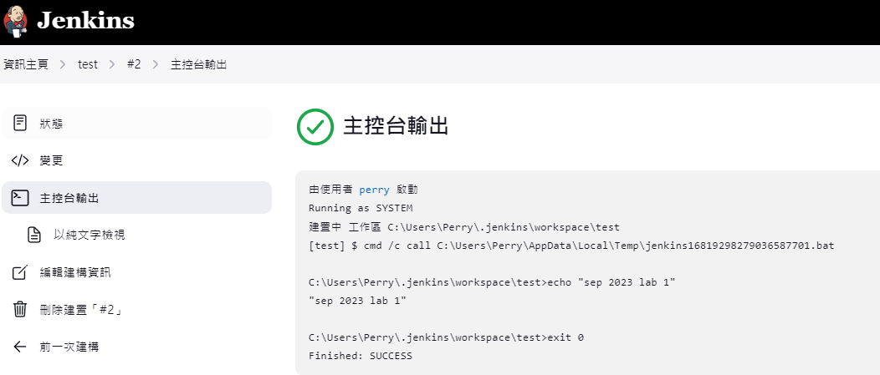
Lab 1 requirement
Modify Execute Windows batch command section and Save:
Screenshot the console output and submit to eeclass.
echo "sep 2023 lab 1“ exit 0
Notes:
build error :檔案名稱、目錄名稱或磁碟區標籤語法錯誤。
上面的雙引號重打

Slide 17
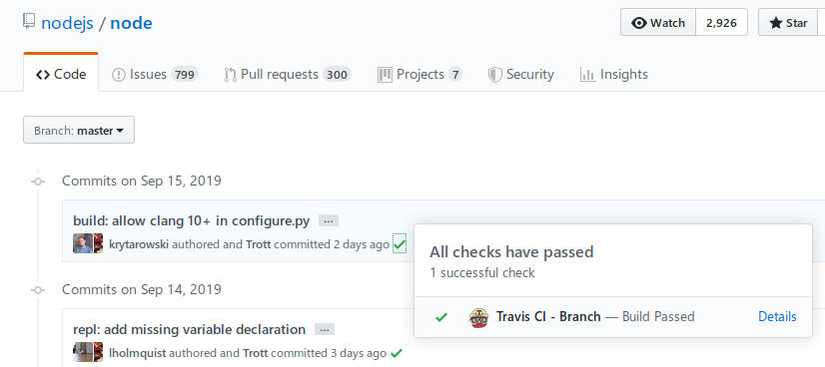
Git Webhook
When a new version of code is available on the git version control system, automatically trigger Jenkins/CI tools to build/test the code. https://docs.gitlab.com/ee/user/project/integrations/webhooks.html https://docs.gitlab.com/ee/integration/jenkins.html
Can help you to integrate version control and automation server better
Notes:
這是之後做term project會用到的東西，大家可以自己去了解

Slide 18
Other famous CI/CD tools
Travis CI - famous for open source projects
Gitlab CI/CD
GitHub Flow/Actions
Circle CI
Slack

